Slide 1
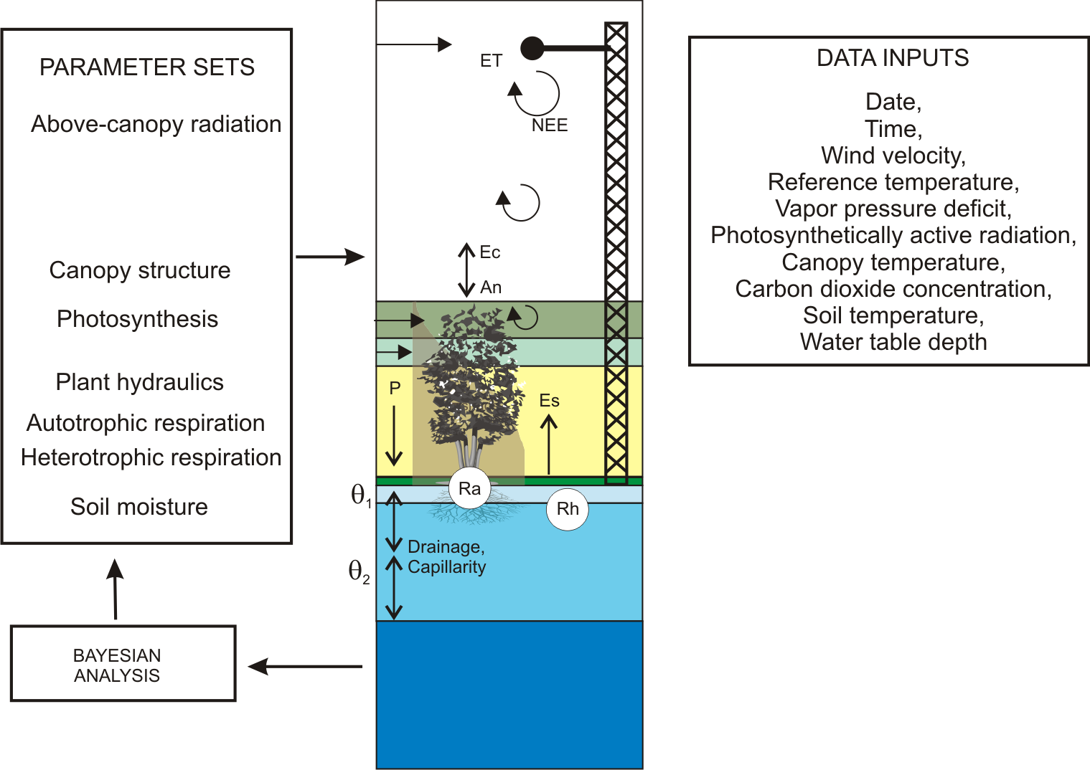
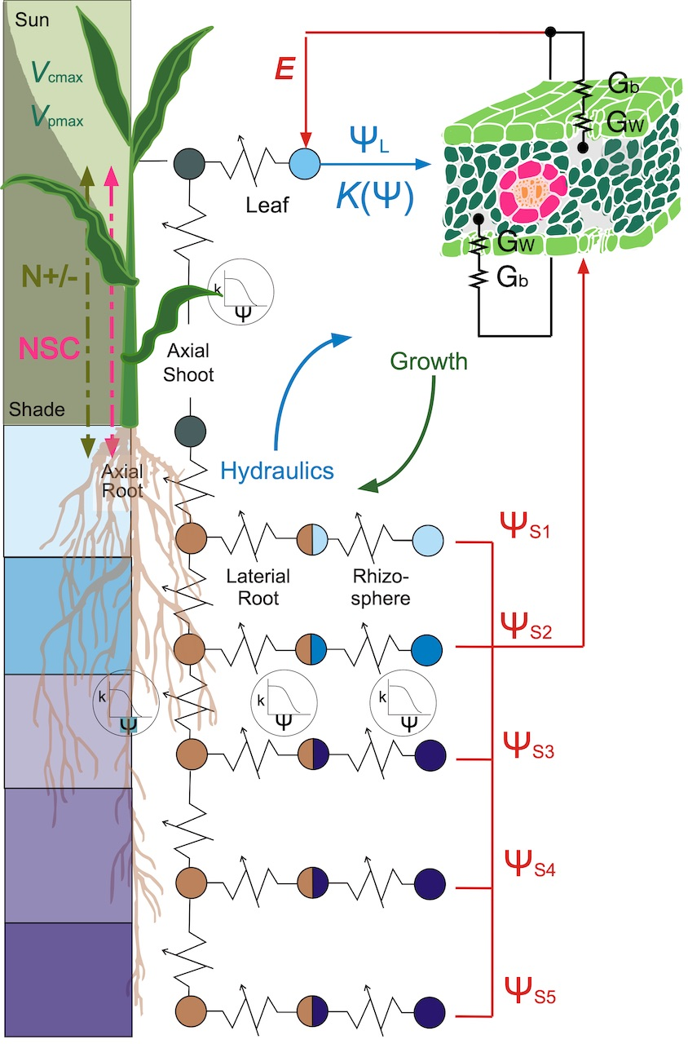
TREES Workshop:
Theory, Research Questions, and Hands-on Use
D. Scott Mackay, Mitchell Hitchcock and Diane R. Wang
University at Buffalo
Purdue University
Photo: Scott Mackay

Slide 2
TREES Workshop – Learning Objectives
Understand the major processes in TREES
Become comfortable with running TREES
Get data into TREES
Apply TREES to address research questions

Slide 3
Major Processes in TREES
1. Leaf/Canopy – energy relations
2. Leaf/Canopy diffusive conductance
3. Photosynthesis (C3 and C4)
4. Vegetative growth
5. Soil-xylem hydraulics
6. Vadose zone soil physics
7. Nitrogen dynamics

Slide 4
1. Leaf/Canopy– energy relations
41.367 latitude
-105.238 longitude
Campbell & Norman 1998

Slide 5
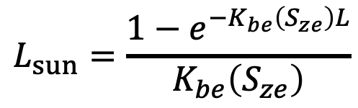
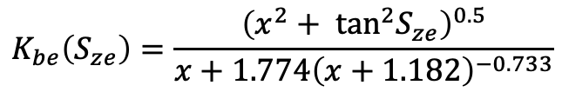
1. Leaf/Canopy– energy relations
$$K_{be}\left(S_{ze}\right)=\frac{{\left(x^{2}+ \tan^{2}S_{ze}\right)}^{0.5}}{x+1.774{\left(x+1.182\right)}^{−0.733}}$$
$$L_{sun}=\frac{1−e^{−K_{be}\left(S_{ze}\right)L}}{K_{be}\left(S_{ze}\right)}$$
1.0 l_angle, spherical, may sample
Campbell & Norman 1998

Slide 6
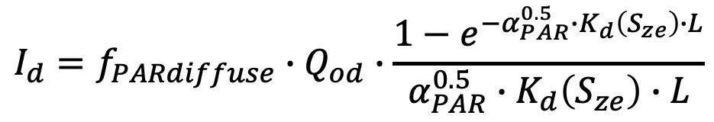
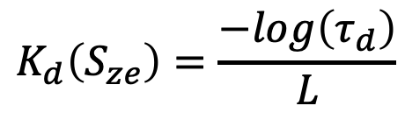
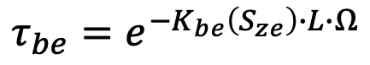
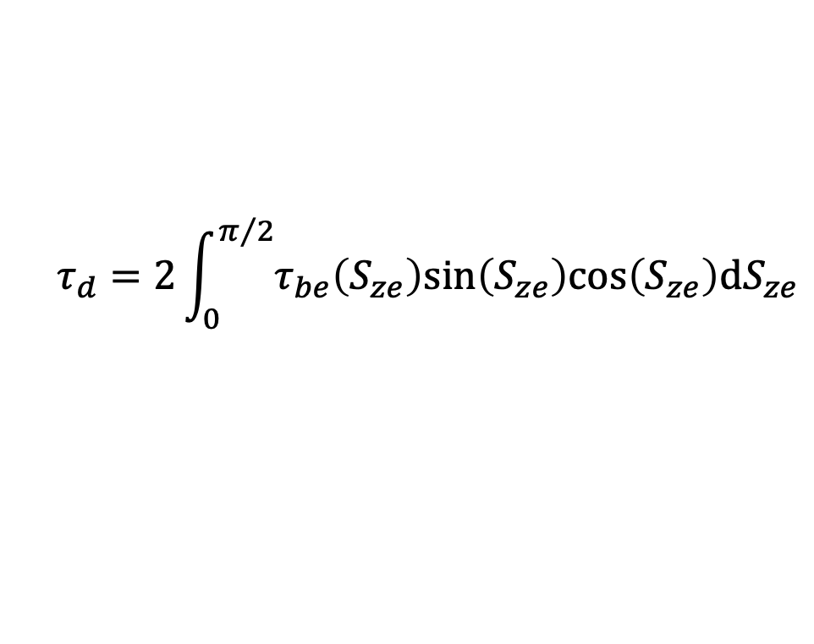
1. Leaf/Canopy– energy relations
$$K_{d}\left(S_{ze}\right)=\frac{−log\left(τ_{d}\right)}{L}$$
$$τ_{d}=2\int_{0}^{π/2}{τ_{be}\left(S_{ze}\right)sin\left(S_{ze}\right)cos\left(S_{ze}\right)dS_{ze}}$$
$$τ_{be}=e^{−K_{be}\left(S_{ze}\right)∙L∙Ω}$$
0.5 omega
$$I_{d}=f_{PARdiffuse}∙Q_{od}∙\frac{1−e^{−{α_{PAR}^{0.5}∙K}_{d}\left(S_{ze}\right)∙L}}{α_{PAR}^{0.5}∙K_{d}\left(S_{ze}\right)∙L}$$
0.8 alpha_PAR
0.5 fPAR_beam
0.5 fPAR_diff
Scattered light is also computed
Campbell & Norman 1998

Slide 7
2. Leaf/Canopy diffusive conductance
0.3 canopy_height, m
0.5 d_factor, C&Nfig5.5
0.1 zm_factor, C&Nfig5.5
0.2 zh_factor, 7.19
X
0.45 z_ref, m

Slide 8
3. Photosynthesis
= 0.5 V_{cmax}
0.01 Rd_mult, Rd=Rd_mult*Vcmax
1.85 Jmax_mult, ratio of Jmax to Vcmax
0.80 thetaJ, curvature parameter
0.4 phiJ_sun, quantum yield, e-/photon
0.4 phiJ_shd, quantum yield, e-/photon
von Caemmerer 2013

Slide 9
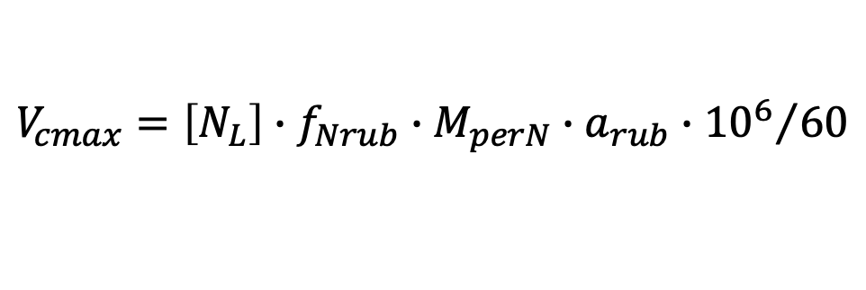
3. Photosynthesis (Original C3 model)
$$V_{cmax}=\left[N_{L}\right]∙f_{Nrub}∙M_{perN}∙a_{rub}∙{{10}^{6}}/{60}$$
umol m⁻² s⁻¹ = kg Nleaf m⁻² x kg Nrub kg⁻¹ Nleaf x kg Rub kg⁻¹ Nrub x umol kg⁻¹ Rub s⁻¹
f_{Nrub} = weight of Rubisco to its N content weight = 7.16 kg Rub kg-1Nrub
Using the parameters below yields Vcmax = 155.9 umol m⁻² s⁻¹
3.6 act25, (umol/mgRubisco/min) Rubisco activity
0.001815 Nleaf
0.2 Nrubisco, proportion

Slide 10
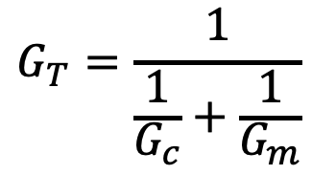
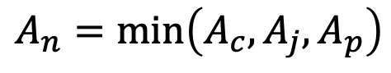
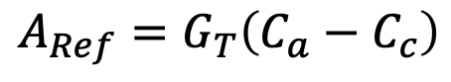
3. Photosynthesis (new C3 model)
$$A_{Ref}=G_{T}\left(C_{a}−C_{c}\right)$$
A_{ref} declines as C_{c} increases
A_{n} increases as C_{c} increases
Find where A_{n} = A_{ref}
$$G_{T}=\frac{1}{\frac{1}{G_{c}}+\frac{1}{G_{m}}}$$
$$A_{n}=min\left(A_{c}, A_{j},A_{p}\right)$$
von Caemmerer 2013
80.0 Vcmax25, maximum Rubisco activity at 25 C, umol m-2 s-1
140.0 Jmax25, maximum electron transport rate at 25 C, umol m-2 s-1
38.6 gammaStar25, compensation point at 25 C, umol

Slide 11
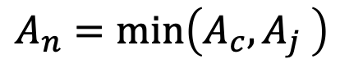
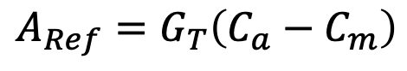
3. Photosynthesis (C4 model)
$$A_{Ref}=G_{T}\left(C_{a}−C_{m}\right)$$
A_{ref} declines as C_{c} increases
A_{n} increases as C_{c} increases
Find where A_{n} = A_{ref}
$$G_{T}=\frac{1}{\frac{1}{G_{c}}+\frac{1}{G_{m}}}$$
$$A_{n}=min\left(A_{c}, A_{j} \right)$$
von Caemmerer 2013
60.0 Vcmax25, maximum Rubisco activity at 25 C, umol m-2 s-1
100.0 Vpmax25, maximum PEP carbolylase activity at 25 C, umol m-2
400.0 Jmax25, maximum electron transport rate at 25 C, umol m-2 s-1
38.6 gammaStar25, compensation point at 25 C, umol
80.0 Kp25, Michaelis constant of PEP carboxylase for CO2 at 25 C, ubar
80.0 Vpr, PEP regeneration rate, umol m-2 s-1

Slide 12
4. Vegetative growth: Leaf (Brassica)
11.211 leafAreaMax // K
0.939134 initialLeafSize //A_pot_in
0.000495803 leafArea_Rate //r
11024.02 dur_LeafExpansion//d_exp
400.0 SLA_max //SLA_max
71.1034 SLA_min //SLA_min
60 leaf_insertAngle //
2.5 leaf_len_to_width //
0.90 proportion_CD //a
1970.534 phyllochron //phyllochron
13507.5 floweringTime //TTF
0.96 Tbase //Tb
4926.335 therm_plant
15.0 projectedArea_init
40.0 pot_size //max projected area, cm2
0.43 root_to_shoot
1.59 leaf_to_stem
Wang et al., 2019, Journal of Experimental Botany

Slide 13
4. Vegetative growth: Roots
#_of_shoot_modules 1
leaf_area_fraction 1
length_lateral 0.48
length_axial 0.2
#_of_root_modules 4
leaf_area_fraction 0.2
length_lateral 1.0
length_axial 0.008
leaf_area_fraction 0.2
length_lateral 1.0
length_axial 0.016
leaf_area_fraction 0.3
length_lateral 1.0
length_axial 0.024
leaf_area_fraction 0.3
length_lateral 1.0
length_axial 0.048
Axial length = 0.96 m
Lateral0 length = 0.96 x 1.0 = 0.96 m
Mackay et al., 2019, New Phytologist

Slide 14
4. Vegetative growth: Roots
79200.0 Cbelowground, kg ha-1
0.00024 Croot_frac, dim
1454.0 SRL1, m gC-1 at root diameter of 250 um
0.000125 minRootDiam, m diameter of thickest root
0.004 maxRootDiam, m diameter of thickest root
1.0 minRootLifespan, years,
Mackay et al., 2019, New Phytologist

Slide 15
4. Vegetative growth: Roots
Mackay et al., 2019, New Phytologist

Slide 16
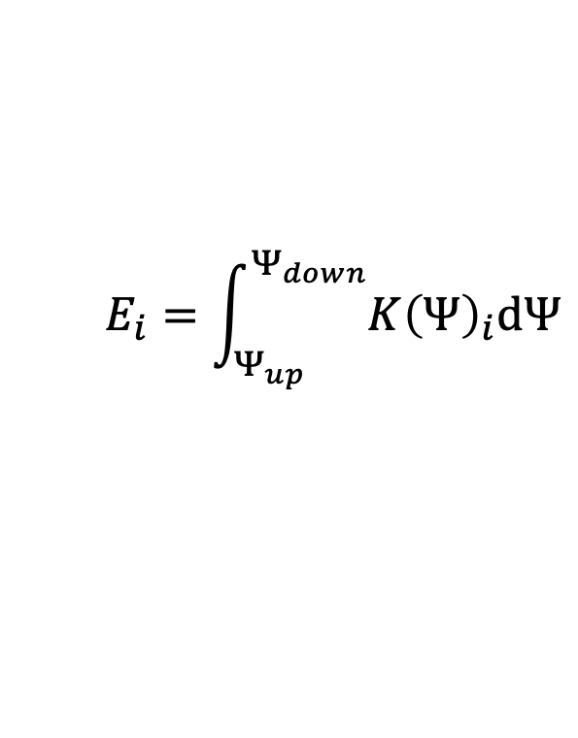
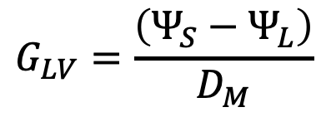
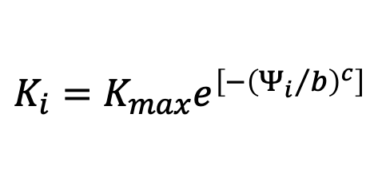
5. Soil-Xylem hydraulics
0.15 Gsref
0.54 m (proportion of Gsref)
$$G_{LV}=\frac{\left(Ψ_{S}−Ψ_{L}\right)}{D_{M}}$$
$$E_{i}=\int_{Ψ_{up}}^{Ψ_{down}}{{K\left(Ψ\right)}_{i}dΨ}$$
$$K_{i}=K_{max}e^{\left[−{\left({Ψ_{i}}/b\right)}^{c}\right]}$$
Mackay et al., 2015, Water Resources Research

Slide 17
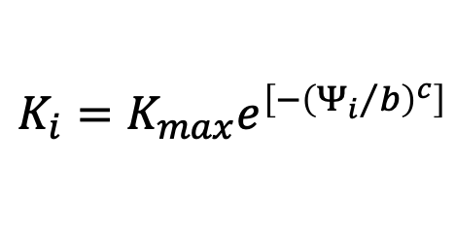
5. Soil-Xylem hydraulics
-0.1 Md (If critical pressure is more positive, then hydraulic failure)
-0.5 midday_at_sat_kl
2.5 e_at_saturated_kl
-0.3 pd_at_sat_kl
1.57 ax_Shoot-b_value_(weibull)
2.38 ax_Shoot-c_value_(weibull)
1.57 lat_Shoot-b_value_(weibull)
2.38 lat_Shoot-c_value_(weibull)
1.57 ax_Root-b_value_(weibull)
2.38 ax_Root-c_value_(weibull)
1.57 lat_Root-b_value_(weibull)
2.38 lat_Root-c_value_(weibull)
}
(Empirical observations to set up the hydraulics)
$$K_{i}=K_{max}e^{\left[−{\left({Ψ_{i}}/b\right)}^{c}\right]}$$

Slide 18
5. Soil-Xylem hydraulics
0.1 GMP_(mm)_geometric_mean_particle_diameter
12.0 GSD_geometric_standard_deviation_of_particle_size

Slide 19
6. Soil Physics
Drainage:
Explicit Richards Equation
Film flow (macropores)
0.4 porosity
0.3 silt_fraction
0.3 clay_fraction

Slide 20
7. Nitrogen dynamics

Slide 21
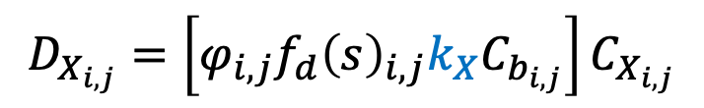
7. Nitrogen dynamics
$$D_{X_{i,j}}=\left[φ_{i,j}f_{d}{\left(s\right)}_{i,j}k_{X}C_{b_{i,j}}\right]C_{X_{i,j}}$$
0.0085 kd, d-1
0.6 kn, m3 d-1 gC-1
0.4 kea, m3 d-1 gC-1 (for exudates)
0.6 kes, m3 d-1 gC-1 (for exudates)
0.000065 kl, m3 d-1 gC-1
0.0000025 kh, m3 d-1 gC-1

Slide 22
7. Nitrogen dynamics
Mineralization (positive) – Immobolization (negative):
Humus
Litter
Amino acid
Sugar (glucose)
Mineralization or Immobolization rate function:

Slide 23
Example: Piñon-juniper have different drought responses
Piñon turns from green to orange just before death
Juniper dies off gradually over several years

Slide 24
Piñon: No xylem refilling and root mortality
(B)
(A)
Refill
Refill
No Refill
(B)
No Refill
Mackay et al., 2015, Water Resources Research

Slide 25
Juniper: No xylem refilling and canopy mortality
(A)
Refill
No Refill
Refill
(B)
No Refill
Mackay et al., 2015, Water Resources Research

